Slide 1
ANTENNA & WAVE PROPOGATION 5th SEM E & T
Course Code:- BEETE501T
Name of Faculty:- Mr. Akbar Nagani
Assistant Professor (Departmennt of Electronics & Telecommunication Engg.

Slide 2
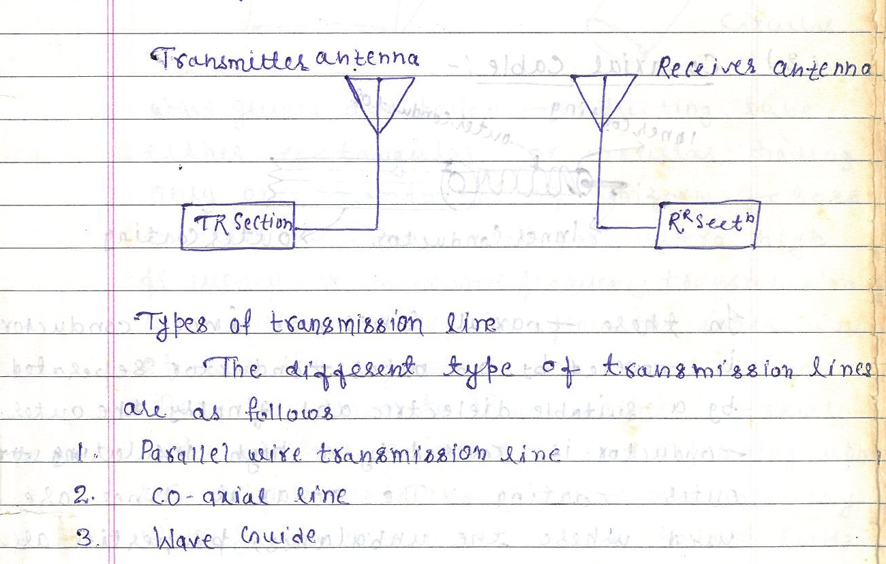
UNIT 01 :-TRANSMISSION LINE

Slide 3
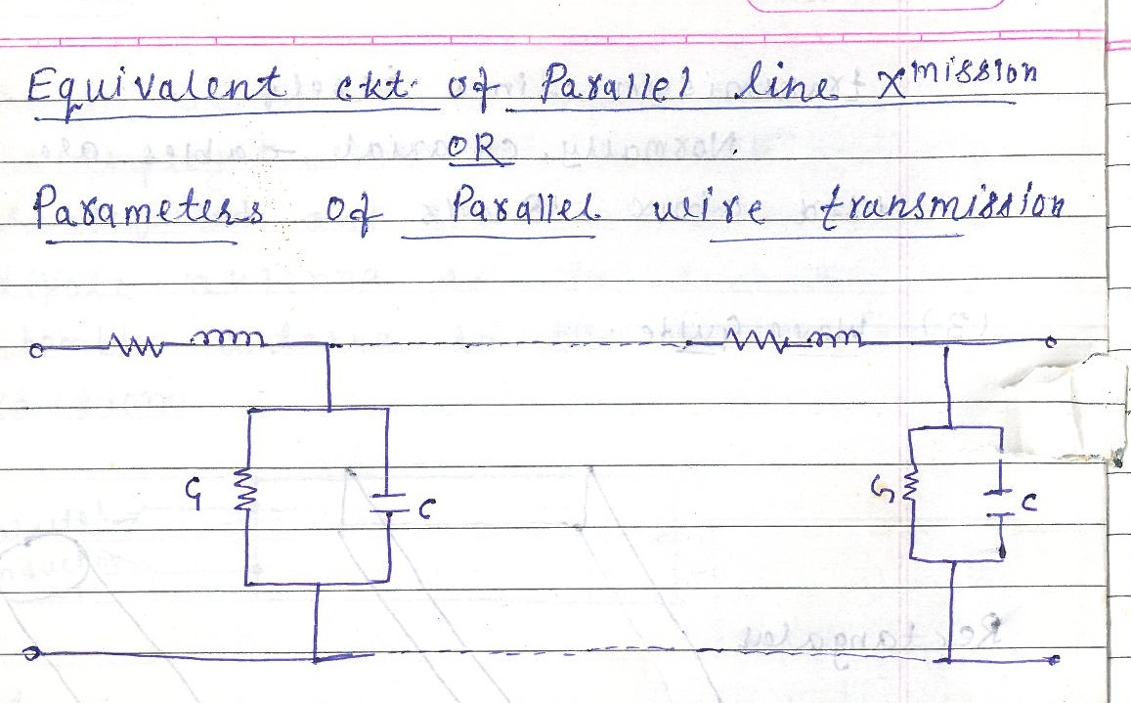
EQUIVALENT CKT OF TRANSMISSION LINE

Slide 4
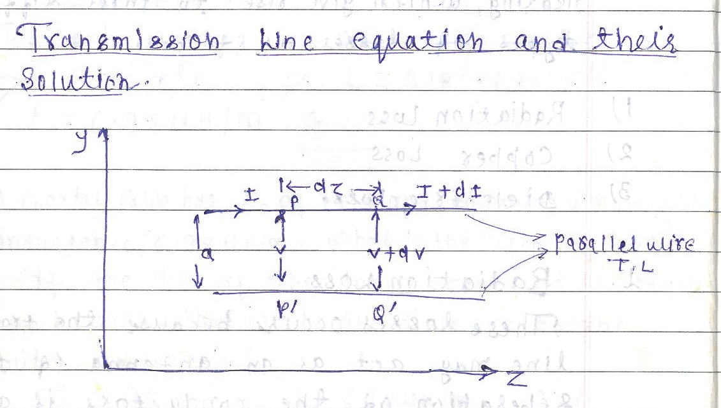
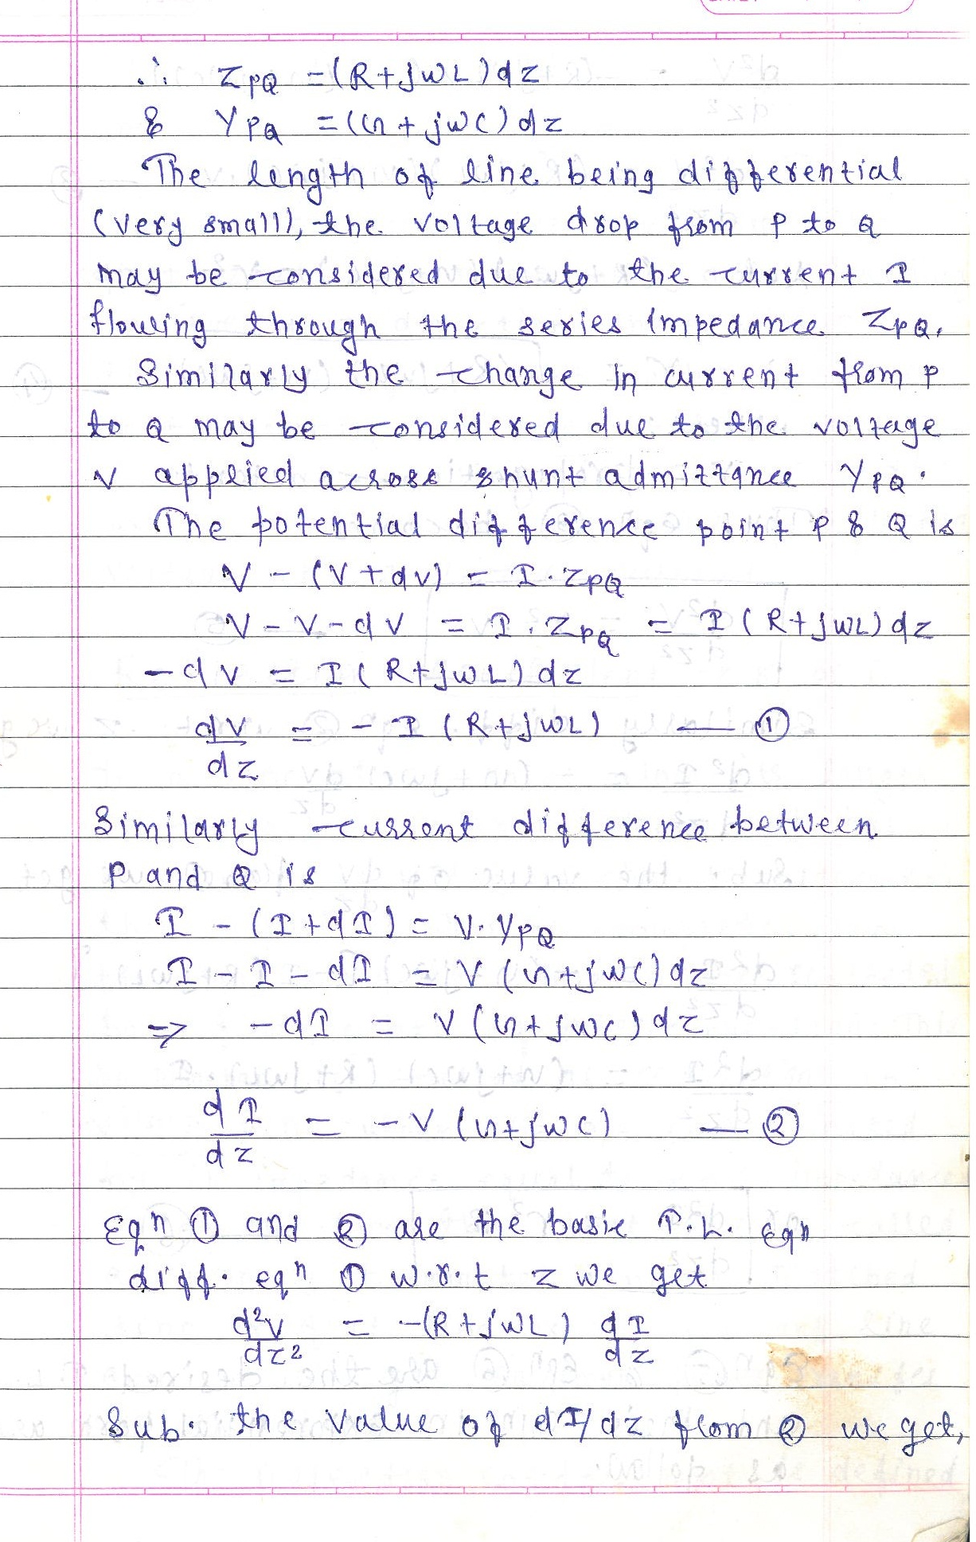

Slide 5
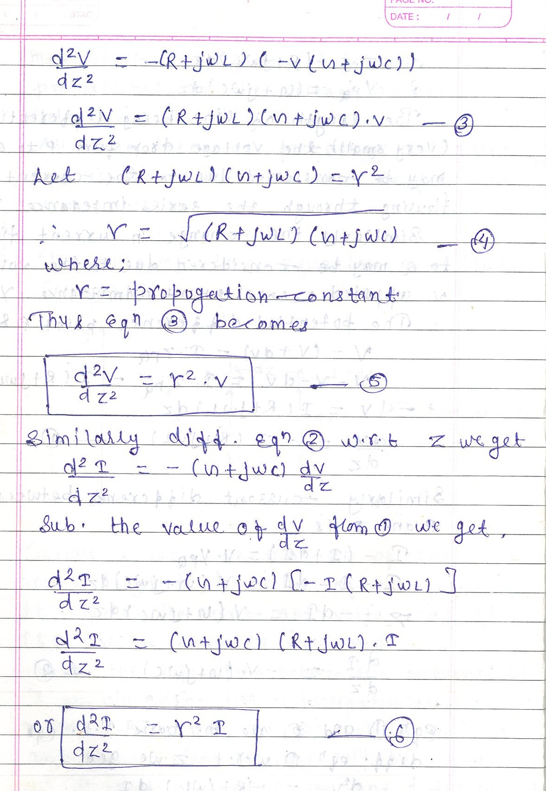

Slide 6
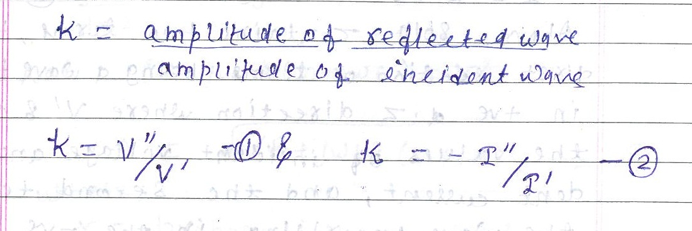
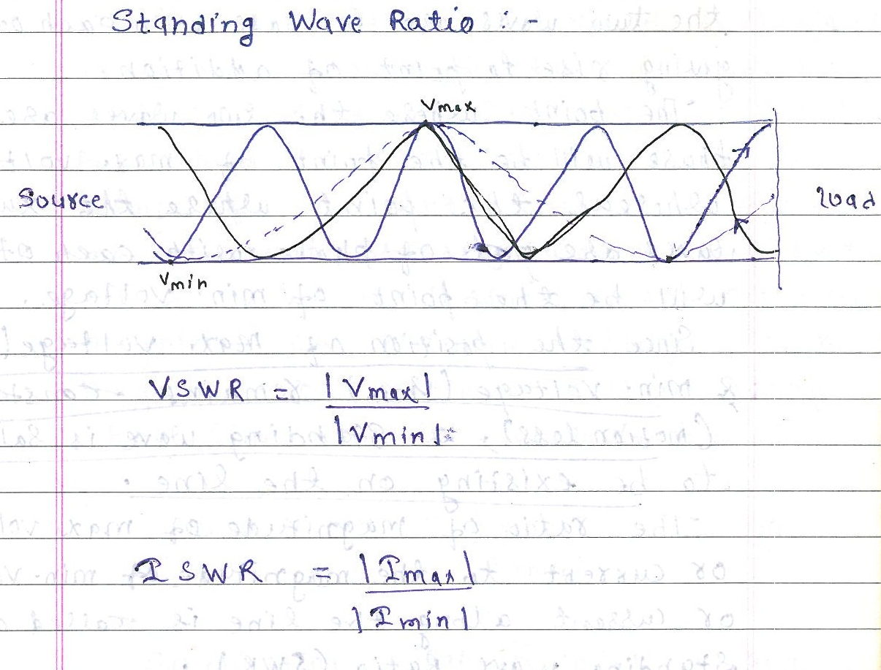

Slide 7
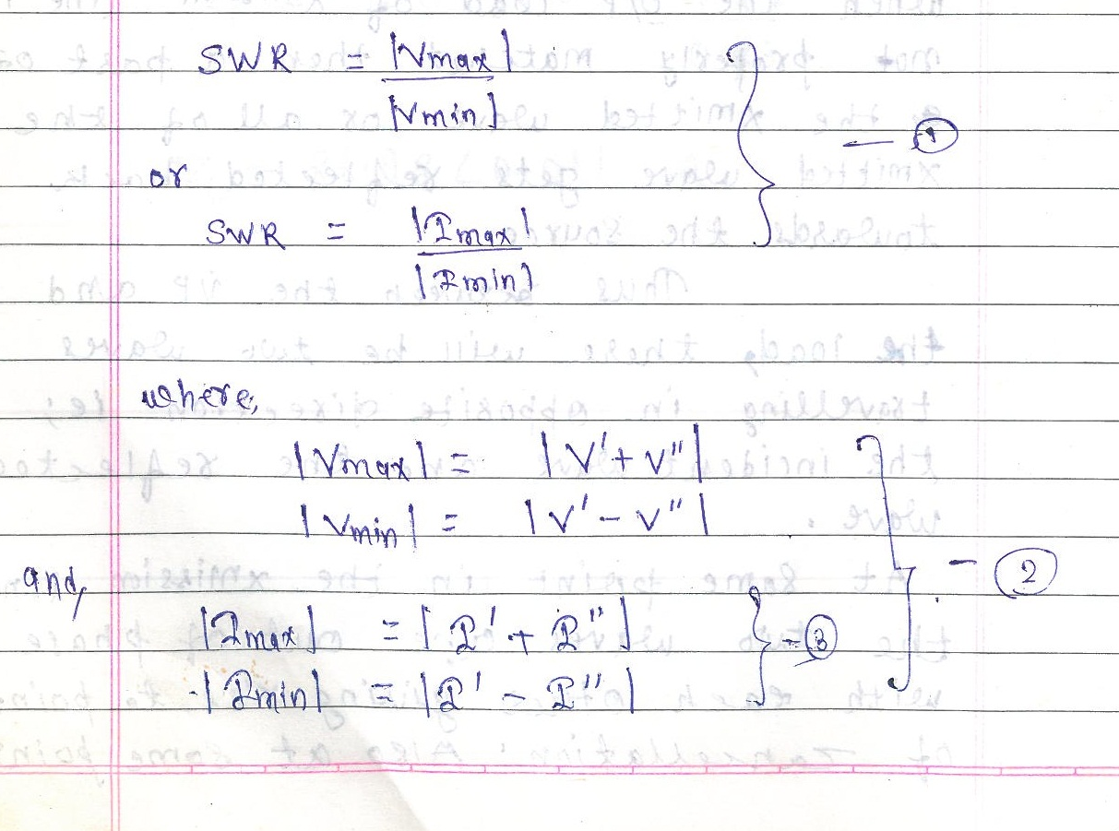

Slide 8
UNIT-02 LINEAR WIRE ANTENNA

